Slide 1

Fraudulent Activities
Emilien NORY

Slide 2
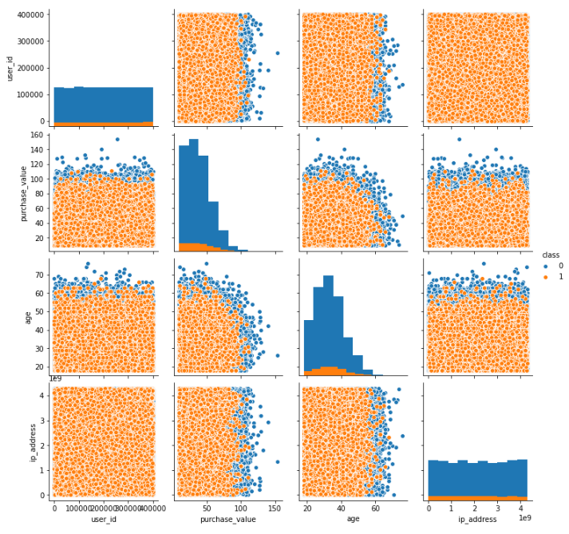
Overview of fraud
Ratio of fraudulent cases: 9%
Ratio of non-fraudulent cases: 91%
5%

Slide 3
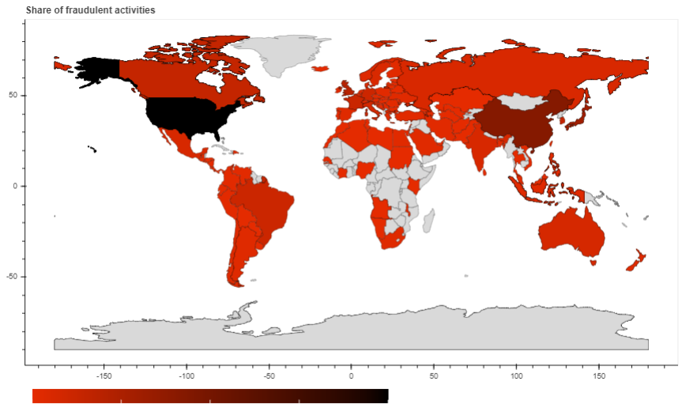
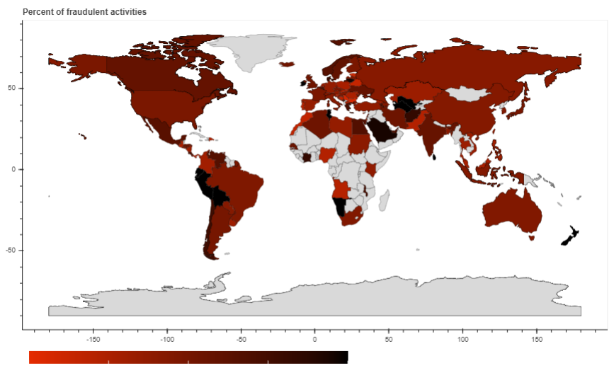
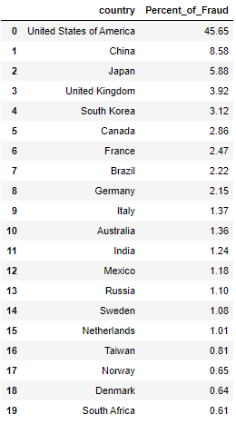
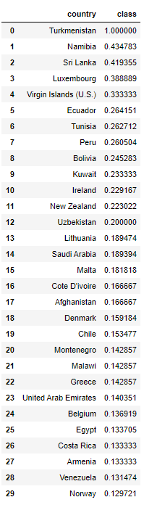
Rank of Country Fraud
45%

Slide 4
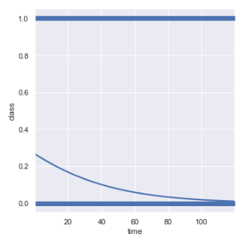
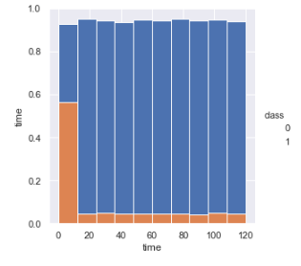

Time is consuming Fraud
65%

Slide 5
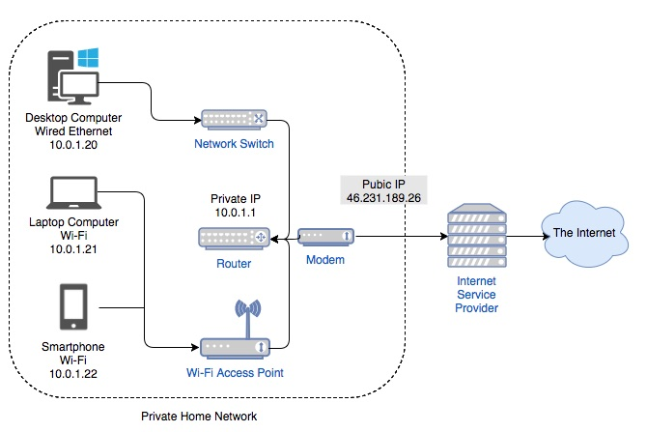
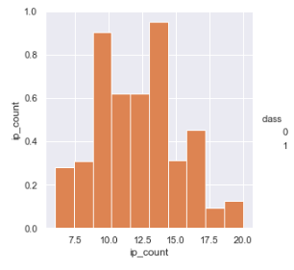
IP Count >5
75%

Slide 6
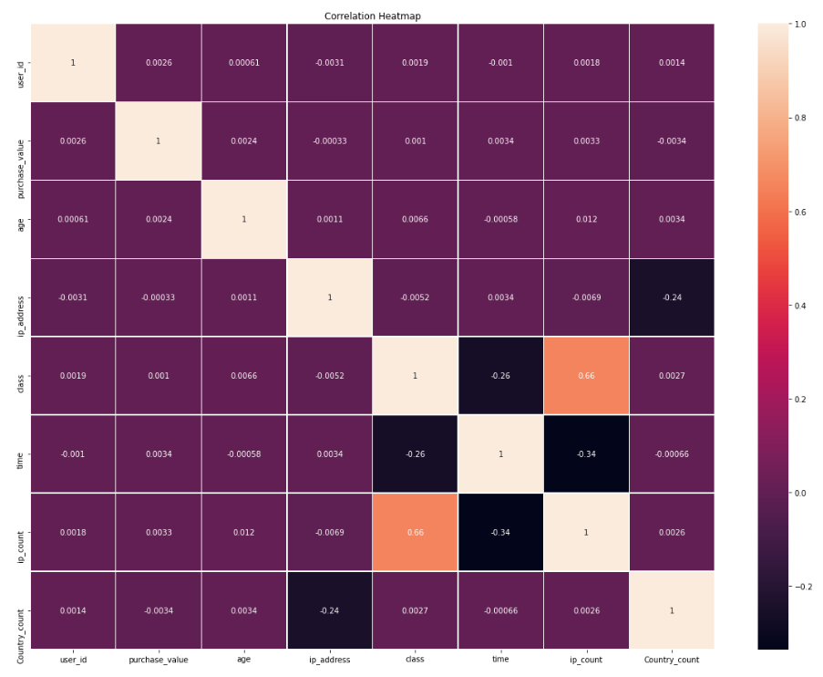
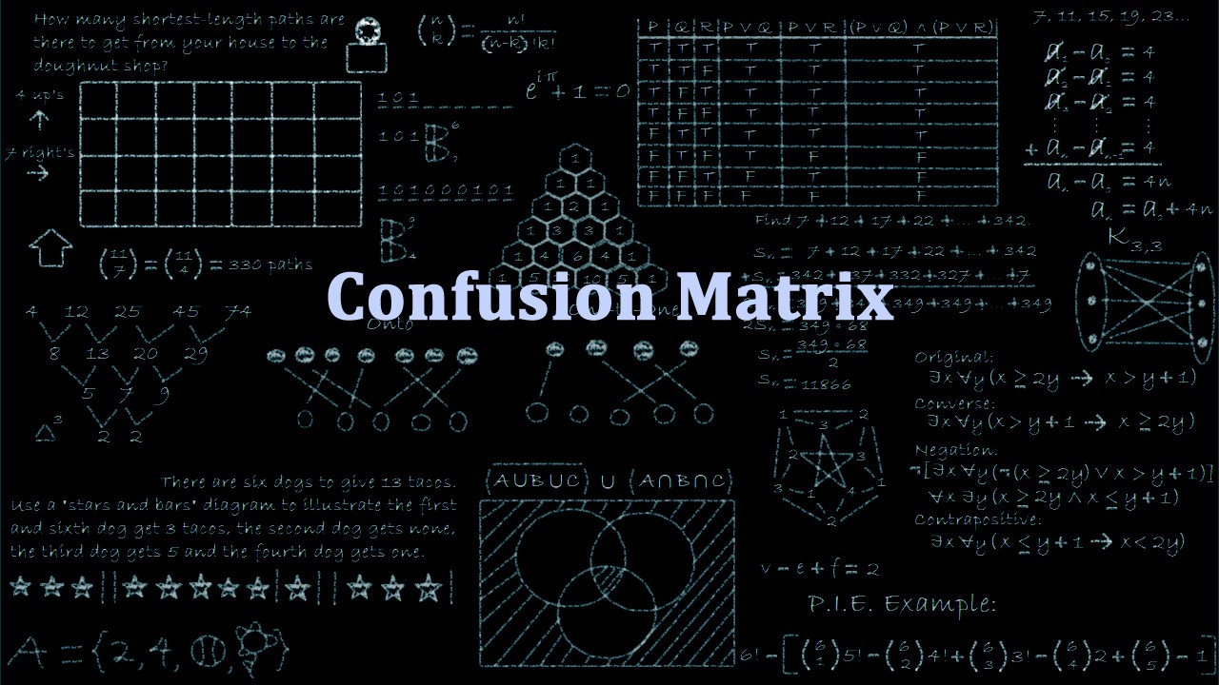
Confusion matrix
When we get the data, after data cleaning…
77%

Slide 7
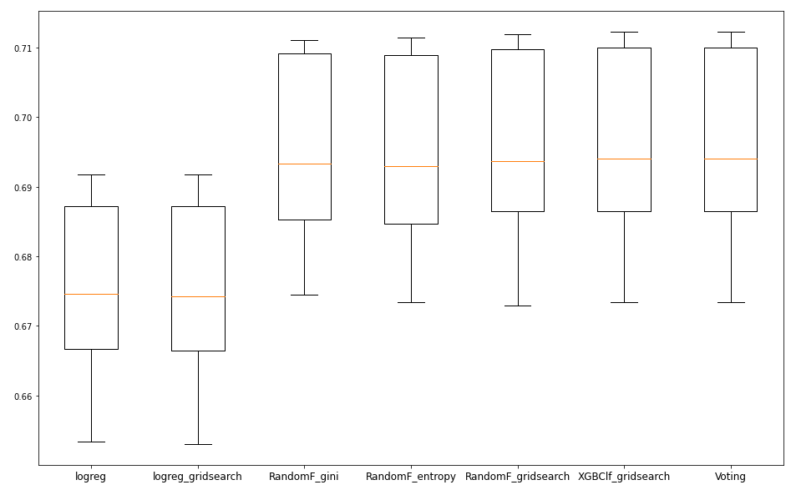
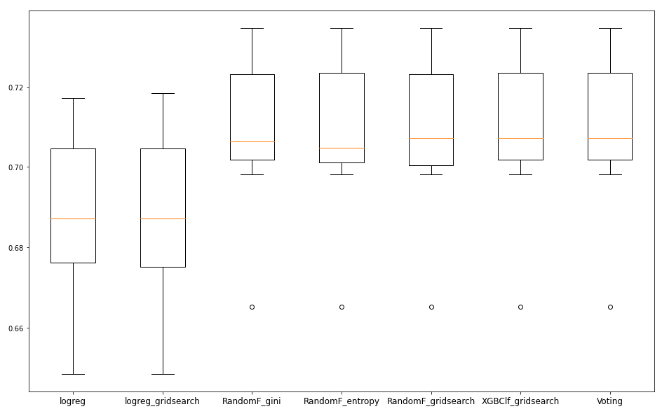
Time to test your models
Train Test split = 0,2
Train
Test
95%

Slide 8
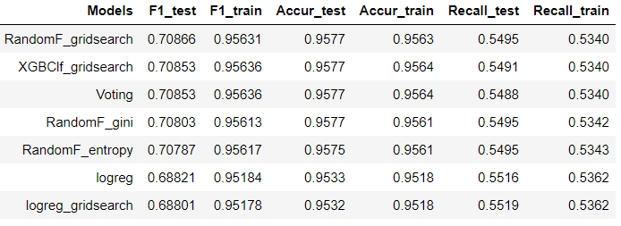



model ranking
Train Test split = 0,2
First
Seconde
Third

Slide 9
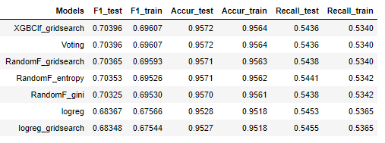
model ranking
Train Test split = 0,33
First
Seconde
Third

Slide 10
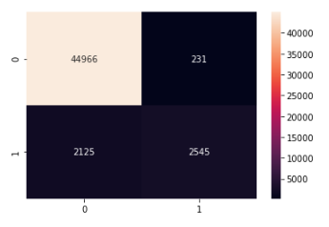
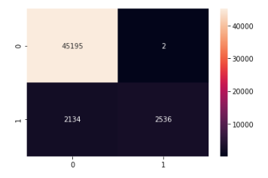
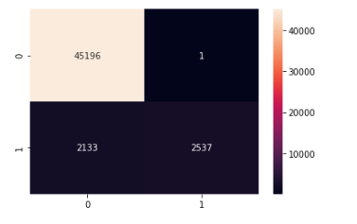
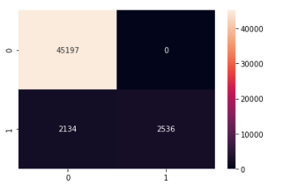
Matrice de confusion
Train Test split = 0,33
Mean Price Fraud : 36.99
Mean Price Without Fraud : 36.93
A
B
A=abs(231*39.99 + 2125*36.93
- 2545*36,99)
A= 6 425,61
B= 14 924,04
C= 15 071,94
D= 14 998,02
C
D

Slide 11

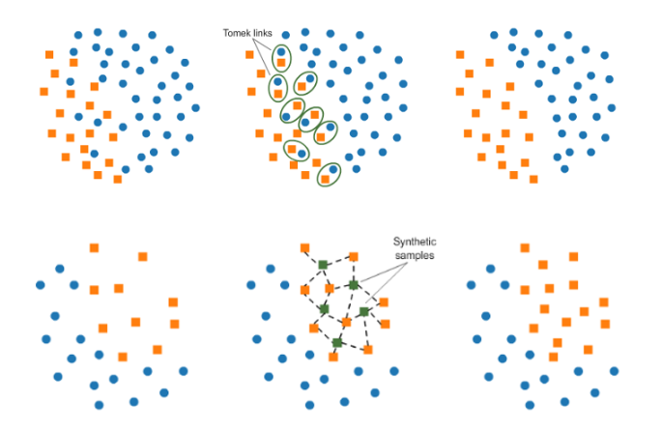
PCA case : SMOTETomek

Slide 12
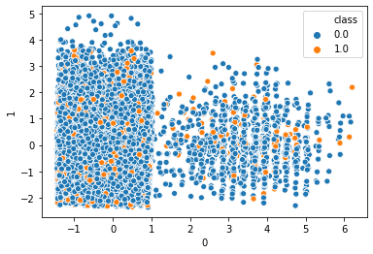
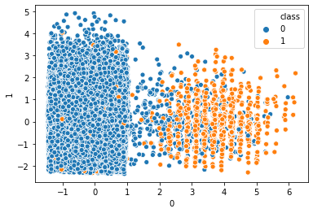
PCA before Smotetomek pca after smotetomek

Slide 13
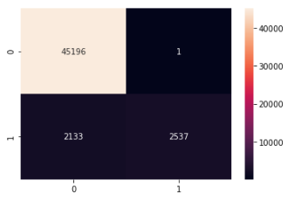
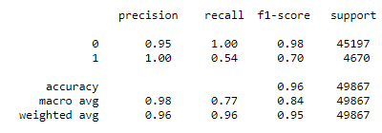
SMOTETOMEK score
100%

